Slide 1
Domain ML
Technology: Python
CANCER PREDICTION IN EARLY SATGES USING MACHINE LEARNING

Slide 2
ABSTRACT
Cancer is a disease characterized by the uncontrolled growth and spread of abnormal cells. Early detection and diagnosis of cancer are essential for successful treatment and management of the disease. Machine learning (ML) is a promising approach that can assist in predicting cancer at an early stage, which can lead to better patient outcomes. Several ML algorithms have been applied to predict cancer in its early stages, including decision trees, support vector machines, neural networks, and random forests. These algorithms can be trained on various types of data, including genomic, proteomic, and imaging data. Genomic data can provide important information about gene expression patterns, DNA mutations, and other molecular features of cancer cells. Proteomic data can provide insights into the protein expression patterns that may be indicative of cancer. Imaging data, such as CT and MRI scans, can also provide valuable information about the presence and extent of cancerous lesions. Overall, ML has shown promise as a tool for predicting cancer in its early stages. As the field of ML continues to evolve and improve, it is likely that these algorithms will become even more accurate and reliable in predicting cancer.
Keywords: Machine Learning, Random Forest, Logistic Regression, Decision Tree, ML techniques, evaluation.

Slide 3
INTRODUCTION
Cancer research has undergone a continuous evolution over the last few decades [1]. Scientists used various methods, such as early stage screening, to detect cancer types before they cause symptoms. Furthermore, they have created new strategies for predicting cancer treatment outcomes early on. Large amounts of cancer data have been collected and made available to the medical research community as a result of the introduction of new technologies in the field of medicine. However, accurate disease prediction is one of the most interesting and difficult tasks for physicians. As a result, machine learning methods have grown in popularity among medical researchers. These techniques can discover and identify patterns and relationships between them, from complex datasets, while they are able to effectively predict future outcomes of a cancer type. Given the significance of personalized medicine and the growing trend on the application of ML techniques, we here present a review of studies that make use of these methods regarding the cancer prediction and prognosis.

Slide 4
In these studies prognostic and predictive features are considered which may be independent of a certain treatment or are integrated in order to guide therapy for cancer patients, respectively [2]. In addition, we discuss the types of ML methods being used, the types of data they integrate, the overall performance of each proposed scheme while we also discuss their pros and cons. Cancer is a disease that affects millions of people worldwide and is responsible for a significant number of deaths every year. Early detection of cancer is crucial in improving the prognosis and increasing the chances of successful treatment. Machine learning (ML) algorithms have shown promising results in predicting cancer in its early stages, which can lead to timely intervention and better outcomes for patients. The prediction of cancer using ML involves analyzing large amounts of data and identifying patterns and trends that are indicative of cancer. The data used in ML models can include patient information, such as age, gender, family history, lifestyle habits, and medical history.

Slide 5
It can also include biomarkers, such as genetic mutations, abnormal proteins, or imaging data, that are associated with cancer. One of the most common ML techniques used in cancer prediction is supervised learning, which involves training a model on labeled data. Labeled data is data that has been categorized or labeled with a target variable, such as cancer or no cancer. The model learns to recognize patterns in the labeled data and makes predictions based on these patterns. The model is then tested on new, unlabeled data to evaluate its accuracy.

Slide 6

Literature survey:
S. No | Journal Type with year | Authors | Title | Outcomes
1 | Conference ICT, Cell 2011;144: 646–74. | Hanahan D, Weinberg RA. Hallmarks | cancer: the next generation. | tumor microenvironment
2 | Conference (IEMCON), Vancouver, 2006;2:59. | Cruz JA, Wishart DS | Applications of machine learning in cancer prediction and prognosis | clinical utility assessment
3 | ” Conference ,pp. 1–52, 2013;4. | Madhavan D, Cuk K, Burwinkel B, Yang R | Cancer diagnosis and prognosis decoded by blood-based circulating microRNA signatures | microRNAs
4 | Conference vol. 53, pp. 62–74, 2018 | zen k, zhang cy | A novel class of biomarkers to diagnose and monitor human cancers | human epithelial malignancies

Slide 7
EXISTING SYSTEM
In the existing system, implementation of machine learning algorithms is bit complex to build due to the lack of information about the data visualization. Machine learning has been widely used in the medical field to improve the diagnosis and treatment of various diseases, including cancer. Early detection of cancer is crucial for successful treatment, and machine learning models have been developed to predict cancer in its early stages. To overcome all this, we use machine learning packages available in the scikit-learn library.
Disadvantages:
High complexity.
Time consuming.

Slide 8
PROPOSED SYSTEM
Proposed several machine learning models to classify cancer stages . These machine learning systems have the potential to greatly improve the early detection of cancer and ultimately save lives. By analyzing large amounts of patient data, these systems can identify patterns and trends that may not be immediately apparent to human doctors. This allows for earlier detection and more effective treatment of cancer. Therefore, we propose a Random Forest, Logistic Regression and Decision Tree machine Classifier to predict the levels.
Advantages:
Highest accuracy
Reduces time complexity.
Easy to use

Slide 9
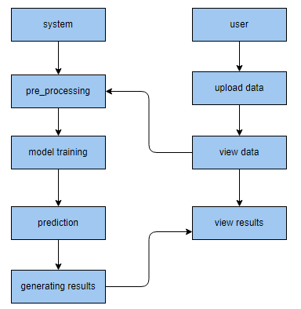
PROPOSED METHOD

Slide 10
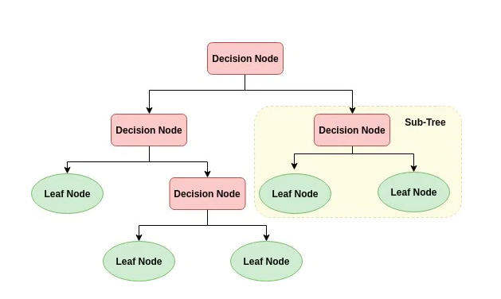
ALGORITHMS
Decision Tree:
Decision tree is a flowchart-like tree structure where an internal node represents feature(or attribute), the branch represents a decision rule, and each leaf node represents the outcome. The topmost node in a decision tree is known as the root node. It learns to partition on the basis of the attribute value. It partitions the tree in recursively manner call recursive partitioning. This flowchart-like structure helps you in decision making. It's visualization like a flowchart diagram which easily mimics the human level thinking. That is why decision trees are easy to understand and interpret.

Slide 11
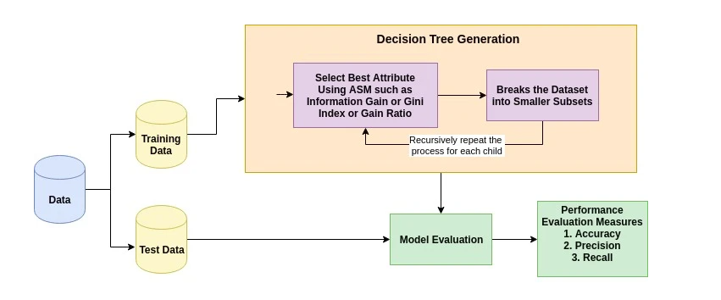
The basic idea behind any decision tree algorithm is as follows:
Select the best attribute using Attribute Selection Measures (ASM) to split the records.
Make that attribute a decision node and breaks the dataset into smaller subsets.
Starts tree building by repeating this process recursively for each child until one of the conditions will match:
All the tuples belong to the same attribute value.
There are no more remaining attributes.
There are no more instances.

Slide 12
2. Logistic Regression:
Logistic Regression was used in the biological sciences in early twentieth century. It was then used in many social science applications. Logistic Regression is used when the dependent variable(target) is categorical. For example,
To predict whether an email is spam (1) or (0)
Whether the tumor is malignant (1) or not (0)
Consider a scenario where we need to classify whether an email is spam or not. If we use linear regression for this problem, there is a need for setting up a threshold based on which classification can be done. Say if the actual class is malignant, predicted continuous value 0.4 and the threshold value is 0.5, the data point will be classified as not malignant which can lead to serious consequence in real time.
From this example, it can be inferred that linear regression is not suitable for classification problem. Linear regression is unbounded, and this brings logistic regression into picture. Their value strictly ranges from 0 to 1.

Slide 13
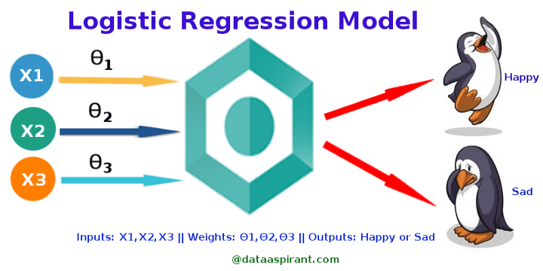
Where to use logistic regression :
Logistic regression is used to solve classification problems, and the most common use case is binary logistic regression, where the outcome is binary (yes or no). In the real world, you can see logistic regression applied across multiple areas and fields.
In health care, logistic regression can be used to predict if a tumor is likely to be benign or malignant.
In the financial industry, logistic regression can be used to predict if a transaction is fraudulent or not.
In marketing, logistic regression can be used to predict if a targeted audience will respond or not.

Slide 14
The three types of logistic regression :
Binary logistic regression - When we have two possible outcomes, like our original example of whether a person is likely to be infected with COVID-19 or not.
Multinomial logistic regression - When we have multiple outcomes, say if we build out our original example to predict whether someone may have the flu, an allergy, a cold, or COVID-19.
Ordinal logistic regression - When the outcome is ordered, like if we build out our original example to also help determine the severity of a COVID-19 infection, sorting it into mild, moderate, and severe cases

Slide 15
3. RANDOM FOREST CLASSIFIER:
A random forest is a machine learning technique that’s used to solve regression and classification problems. It utilizes ensemble learning, which is a technique that combines many classifiers to provide solutions to complex problems.
A random forest algorithm consists of many decision trees. The ‘forest’ generated by the random forest algorithm is trained through bagging or bootstrap aggregating. Bagging is an ensemble meta-algorithm that improves the accuracy of machine learning algorithms.
The (random forest) algorithm establishes the outcome based on the predictions of the decision trees. It predicts by taking the average or mean of the output from various trees. Increasing the number of trees increases the precision of the outcome.
A random forest eradicates the limitations of a decision tree algorithm. It reduces the over fitting of datasets and increases precision. It generates predictions without requiring many configurations in packages (like Scikit-learn).

Slide 16
Features of a Random Forest Algorithm:
It’s more accurate than the decision tree algorithm.
It provides an effective way of handling missing data.
It can produce a reasonable prediction without hyper-parameter tuning.
It solves the issue of over fitting in decision trees.
In every random forest tree, a subset of features is selected randomly at the node’s splitting point.
Decision trees are the building blocks of a random forest algorithm. A decision tree is a decision support technique that forms a tree-like structure. An overview of decision trees will help us understand how random forest algorithms work.
A decision tree consists of three components: decision nodes, leaf nodes, and a root node. A decision tree algorithm divides a training dataset into branches, which further segregate into other branches. This sequence continues until a leaf node is attained. The leaf node cannot be segregated further.
The nodes in the decision tree represent attributes that are used for predicting the outcome. Decision nodes provide a link to the leaves. The following diagram shows the three types of nodes in a decision tree.

Slide 17
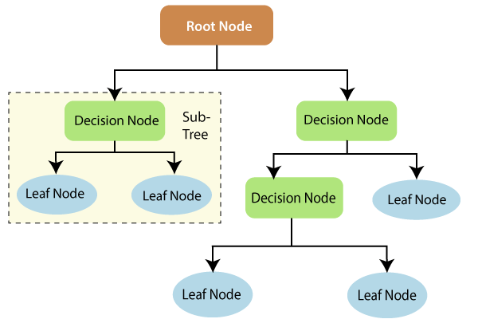
The information theory can provide more information on how decision trees work. Entropy and information gain are the building blocks of decision trees. An overview of these fundamental concepts will improve our understanding of how decision trees are built.
Entropy is a metric for calculating uncertainty. Information gain is a measure of how uncertainty in the target variable is reduced, given a set of independent variables.
The information gain concept involves using independent variables (features) to gain information about a target variable (class). The entropy of the target variable (Y) and the conditional entropy of Y (given X) are used to estimate the information gain. In this case, the conditional entropy is subtracted from the entropy of Y.

Slide 18
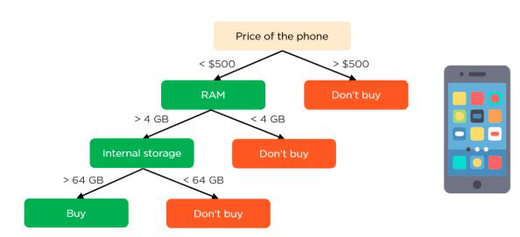
Information gain is used in the training of decision trees. It helps in reducing uncertainty in these trees. A high information gain means that a high degree of uncertainty (information entropy) has been removed. Entropy and information gain are important in splitting branches, which is an important activity in the construction of decision trees.
Let’s take a simple example of how a decision tree works. Suppose we want to predict if a customer will purchase a mobile phone or not. The features of the phone form the basis of his decision. This analysis can be presented in a decision tree diagram.
The root node and decision nodes of the decision represent the features of the phone mentioned above. The leaf node represents the final output, either buying or not buying. The main features

Slide 19
HARDWARE AND SOFTWARE REQUIREMENTS
H/W Configuration:
Operating system : Windows 7 or 7+
RAM : 8 GB
Hard disc or SSD : More than 500 GB
Processor : Intel 3rd generation or high or Ryzen with 8 GB Ram
S/W Configuration:
Software’s : Python 3.6 or high version
IDE : PyCharm.
Framework : Django, pandas, numpy and Scikit-Learn

Slide 20
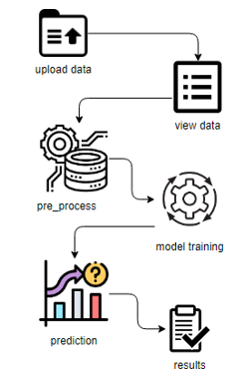
ARCHITECTURE:

Slide 21
UML DIAGRAMS
UML stands for Unified Modelling Language. UML is a standardized general-purpose modelling language in the field of object-oriented software engineering. The standard is managed, and was created by, the Object Management Group.
The goal is for UML to become a common language for creating models of object-oriented computer software. In its current form UML is comprised of two major components: a Meta-model and a notation. In the future, some form of method or process may also be added to; or associated with, UML.
The Unified Modelling Language is a standard language for specifying, Visualization, Constructing and documenting the artefacts of software system, as well as for business modelling and other non-software systems. The UML represents a collection of best engineering practices that have proven successful in the modelling of large and complex systems.
The UML is a very important part of developing objects-oriented software and the software development process. The UML uses mostly graphical notations to express the design of software projects.

Slide 22
GOALS:
The Primary goals in the design of the UML are as follows:
Provide users a ready-to-use, expressive visual modelling Language so that they can develop and exchange meaningful models.
Provide extendibility and specialization mechanisms to extend the core concepts.
Be independent of particular programming languages and development process.
Provide a formal basis for understanding the modelling language.
Encourage the growth of OO tools market.
Support higher level development concepts such as collaborations, frameworks, patterns and components.
Integrate best practices.

Slide 23
USE CASE DIAGRAM
A use case diagram in the Unified Modeling Language (UML) is a type of behavioral diagram defined by and created from a Use-case analysis.
Its purpose is to present a graphical overview of the functionality provided by a system in terms of actors, their goals (represented as use cases), and any dependencies between those use cases.
The main purpose of a use case diagram is to show what system functions are performed for which actor. Roles of the actors in the system can be depicted.

Slide 24
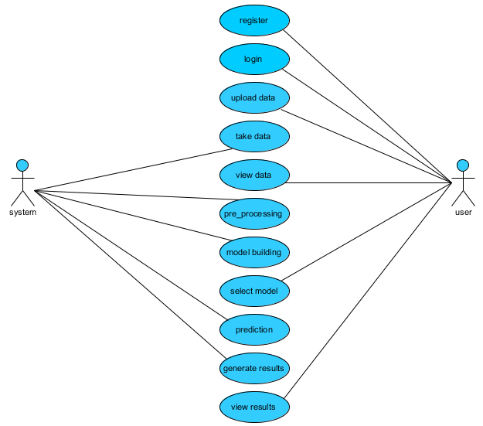

Slide 25
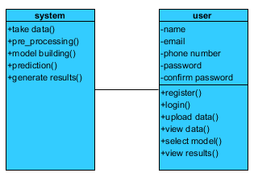
CLASS DIAGRAM
In software engineering, a class diagram in the Unified Modeling Language (UML) is a type of static structure diagram that describes the structure of a system by showing the system's classes, their attributes, operations (or methods), and the relationships among the classes. It explains which class contains information

Slide 26
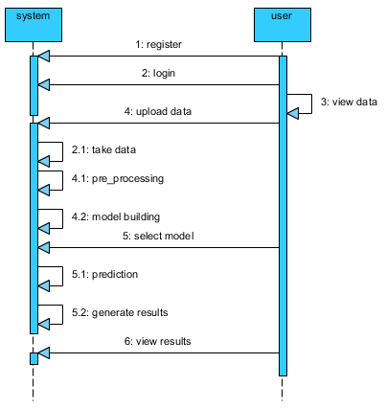
SEQUENCE DIAGRAM
A sequence diagram in Unified Modeling Language (UML) is a kind of interaction diagram that shows how processes operate with one another and in what order.
It is a construct of a Message Sequence Chart. Sequence diagrams are sometimes called event diagrams, event scenarios, and timing diagrams

Slide 27
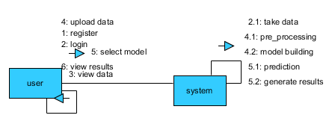
COLLABORATION DIAGRAM:
In collaboration diagram the method call sequence is indicated by some numbering technique as shown below. The number indicates how the methods are called one after another. We have taken the same order management system to describe the collaboration diagram. The method calls are similar to that of a sequence diagram. But the difference is that the sequence diagram does not describe the object organization whereas the collaboration diagram shows the object organization.

Slide 28
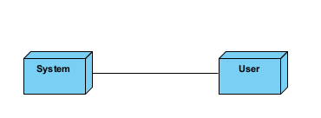
DEPLOYMENT DIAGRAM
Deployment diagram represents the deployment view of a system. It is related to the component diagram. Because the components are deployed using the deployment diagrams. A deployment diagram consists of nodes. Nodes are nothing but physical hardware’s used to deploy the application.

Slide 29
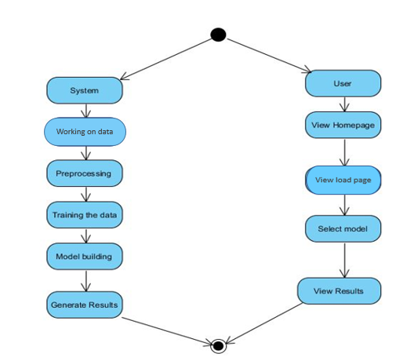
ACTIVITY DIAGRAM:
Activity diagrams are graphical representations of workflows of stepwise activities and actions with support for choice, iteration and concurrency. In the Unified Modelling Language, activity diagrams can be used to describe the business and operational step-by-step workflows of components in a system. An activity diagram shows the overall flow of control.

Slide 30
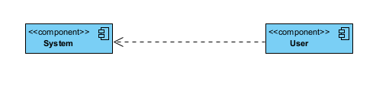
COMPONENT DIAGRAM:
A component diagram, also known as a UML component diagram, describes the organization and wiring of the physical components in a system. Component diagrams are often drawn to help model implementation details and double-check that every aspect of the system's required function is covered by planned development.

Slide 31
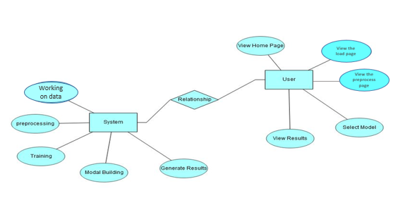
ER DIAGRAM:
An Entity–relationship model (ER model) describes the structure of a database with the help of a diagram, which is known as Entity Relationship Diagram (ER Diagram). An ER model is a design or blueprint of a database that can later be implemented as a database. The main components of E-R model are: entity set and relationship set.
An ER diagram shows the relationship among entity sets. An entity set is a group of similar entities and these entities can have attributes. In terms of DBMS, an entity is a table or attribute of a table in database, so by showing relationship among tables and their attributes, ER diagram shows the complete logical structure of a database. Let’s have a look at a simple ER diagram to understand this concept.

Slide 32
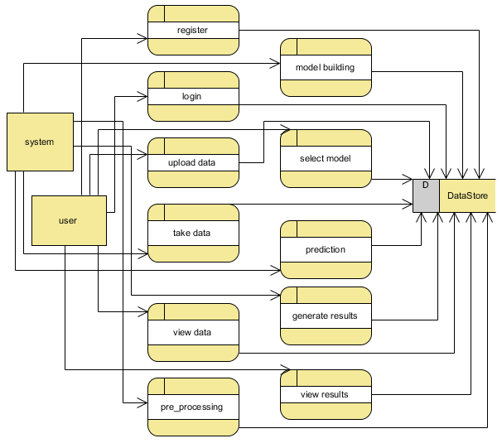
DFD DIAGRAM:
A Data Flow Diagram (DFD) is a traditional way to visualize the information flows within a system. A neat and clear DFD can depict a good amount of the system requirements graphically. It can be manual, automated, or a combination of both. It shows how information enters and leaves the system, what changes the information and where information is stored. The purpose of a DFD is to show the scope and boundaries of a system as a whole. It may be used as a communications tool between a systems analyst and any person who plays a part in the system that acts as the starting point for redesigning a system.

Slide 33
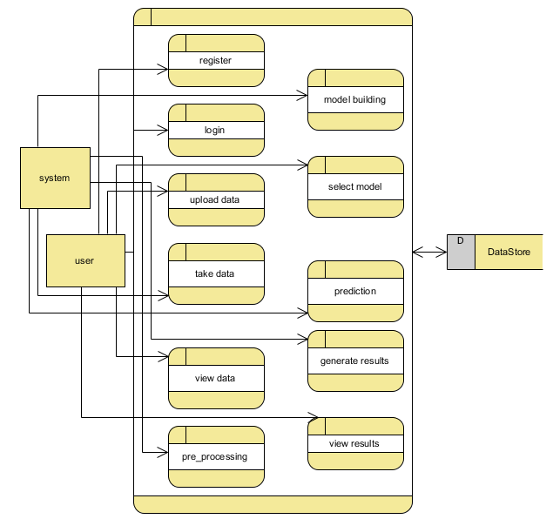

Slide 34
CONCLUSION:
Cancer is a life-threatening disease that affects millions of people worldwide. Early detection and treatment of cancer can significantly improve patient outcomes and survival rates. Machine learning algorithms have shown great promise in accurately predicting cancer in its early stages, which can facilitate early intervention and improve patient outcomes. Machine learning is a subset of artificial intelligence that involves the use of algorithms to learn from data and make predictions or decisions. In the context of cancer prediction, machine learning algorithms can analyse large amounts of data from medical records, genetic tests, imaging scans, and other sources to identify patterns and detect early signs of cancer. Several studies have demonstrated the effectiveness of machine learning in predicting various types of cancer in their early stages. For example, a study conducted by researchers at Stanford University used machine learning to analyze electronic health records and predict the likelihood of patients developing lung cancer. The algorithm was able to accurately predict lung cancer in its early stages, which can increase the chances of successful treatment and improved patient outcomes.

Slide 35
REFERENCES:
[1] Hanahan D, Weinberg RA. Hallmarks of cancer: the next generation. Cell 2011;144: 646–74.
[2] Polley M-YC, Freidlin B, Korn EL, Conley BA, Abrams JS, McShane LM. Statistical and practical considerations for clinical evaluation of predictive biomarkers. J Natl Cancer Inst 2013;105:1677–83.
[3] Cruz JA, Wishart DS. Applications of machine learning in cancer prediction and prognosis. Cancer Informat 2006;2:59.
[4] Fortunato O, Boeri M, Verri C, Conte D, Mensah M, Suatoni P, et al. Assessment of circulating microRNAs in plasma of lung cancer patients. Molecules 2014;19:3038–54.
[5] Heneghan HM, Miller N, Kerin MJ. MiRNAs as biomarkers and therapeutic targets in cancer. Curr Opin Pharmacol 2010;10:543–50.

Slide 36
[6] Madhavan D, Cuk K, Burwinkel B, Yang R. Cancer diagnosis and prognosis decoded by blood-based circulating microRNA signatures. Front Genet 2013;4.
[7] Zen K, Zhang CY. Circulating microRNAs: a novel class of biomarkers to diagnose and monitor human cancers. Med Res Rev 2012;32:326–48.
[8] Koscielny S. Why most gene expression signatures of tumors have not been useful in the clinic. Sci Transl Med 2010;2 [14 ps12-14 ps12].
[9] Michiels S, Koscielny S, Hill C. Prediction of cancer outcome with microarrays: a multiple random validation strategy. Lancet 2005;365:488–92.
[10] Bishop CM. Pattern recognition and machine learning. New York: Springer; 2006

Slide 37


